Slide 1
Implementing Stand UP! in Joomla
INFM 700 Project 3
Sanjeetha Ashiqa Sayeed Myeong Lee
Charanya Subramaniam Rammesh Bryon Baumstarck

Slide 2
OVERVEIW
Project 2
Project 3
Research
Strategy
Design
Implementation
Administration

Slide 3
Feature selection process
Business
Goals
Usability
Communication
Story
Freshness
Encouraging Participation
Conveying
The History
How can we help users to find desired information?
How do we improve user communication?
How can we present Standup stories in fresh way?
With what features can we encourage participation?
How can we convey the history of Standup!?
Features
Needed
Search
Systems
Navigation
Tools
User-Interaction
Multimedia
Discussion
Sharing

Slide 4
Technology selection process
Features
Needed
Search
Systems
Navigation
Tools
User-Interaction
Multimedia
Discussion
Sharing
How can we create a metadata registry to support distributed tagging? | JOOMLA “Allrounder” theme
How do we handle automated categorization of documents?
What about personalization between admin and users?
Can we support global/local/contextual navigation?
What about multimedia, discussion, and sharing features?
How can staff interact with participants?
Tech
Selected
Search Engine
Forms
Gallery
Movie
Slideshow
Social Media
Event
Calendar
Forum
Featured
Articles

Slide 5
Business goals to technologies
Business
Goals
Usability
Communication
Story
Freshness
Encouraging Participation
Conveying
The History
Features
Needed
Search
Systems
Navigation
Tools
User-Interaction
Multimedia
Discussion
Sharing
Tech
Selected
Search Engine
Forms
Gallery
Movie
Slideshow
Social Media
Links
Event
Calendar
Forum
Featured
Articles

Slide 6
Business goals to technologies
Business
Goals
Usability
Communication
Story
Freshness
Encouraging Participation
Conveying
The History
Features
Needed
Search
Systems
Navigation
Tools
User-Interaction
Multimedia
Discussion
Sharing
Tech
Selected
Search Engine
Meta
Tagging
Forms
Movie/
Gallery
Slideshow
Social Media
Links
Event
Calendar
Forum
Featured
Articles

Slide 7
Business goals to technologies
Business
Goals
Usability
Communication
Story
Freshness
Encouraging Participation
Conveying
The History
Features
Needed
Search
Systems
Navigation
Tools
User-Interaction
Multimedia
Discussion
Sharing
Tech
Selected
Search Engine
Meta
Tagging
Forms
Movie/
Gallery
Slideshow
Social Media
Links
Event
Calendar
Forum
Featured
Articles

Slide 8
Business goals to technologies
Business
Goals
Usability
Communication
Story
Freshness
Encouraging Participation
Conveying
The History
Features
Needed
Search
Systems
Navigation
Tools
User-Interaction
Multimedia
Discussion
Sharing
Tech
Selected
Search Engine
Forms
Gallery
Movie
Slideshow
Social Media
Links
Event
Calendar
Forum
Featured
Articles

Slide 9
Business goals to technologies
Business
Goals
Usability
Communication
Story
Freshness
Encouraging Participation
Conveying
The History
Features
Needed
Search
Systems
Navigation
Tools
User-Interaction
Multimedia
Discussion
Sharing
Tech
Selected
Search Engine
Forms
Gallery
Movie
Slideshow
Social Media
Links
Event
Calendar
Forum
Featured
Articles

Slide 10
Business goals to technologies
Business
Goals
Usability
Communication
Story
Freshness
Encouraging Participation
Conveying
The History
Features
Needed
Search
Systems
Navigation
Tools
User-Interaction
Multimedia
Discussion
Sharing
Tech
Selected
Search Engine
Forms
Gallery
Movie
Slideshow
Social Media
Links
Event
Calendar
Forum
Featured
Articles

Slide 11
Showcase
Business
Goals
Usability
Communication
Story
Freshness
Encouraging Participation
Conveying
The History
Features
Needed
Search
Systems
Navigation
Tools
User-Interaction
Multimedia
Discussion
Sharing
Tech
Selected
Search Engine
Forms
Gallery
Movie
Slideshow
Social Media
Links
Event
Calendar
Forum
Featured
Articles

Slide 12

“Sharing” feature
What?
Enables the user to share the current page via over 300 social media sites.
Customized based on the location of the user
Why?
Most affordable way to reach a wide span of prospective volunteers
Helps build loyalty and expand online fan base
Increases page rank and increases the site’s web presence

Slide 13

“Search” feature
What?
Fully internal search engine
Search bar located on every page to improve user experience
Why?
Makes it easy to find specific News articles, educational content etc.
Use the search terms to determine what information visitors are seeking, and redirect future marketing efforts

Slide 14
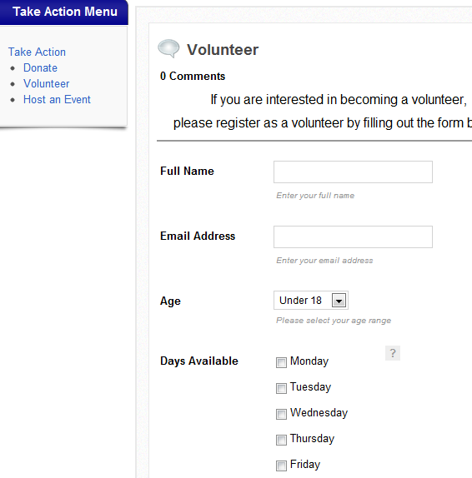
“user interaction” feature
What?
Embedded forms in many pages
Discussion forum
Why?
It provides an intuitive and easy way to engage with Standup!
Encourage users to interact with each other

Slide 15
DEMO
Front-end and Admin side

Slide 16
Additional features
Poll
Featured Articles on the home page
Donate forms
Host an Event form connected to Events Calendar
Discussion Forum

Slide 17
Thank you
QUESTIONS??

