Slide 1

The Next Big Thing Is Really Small
NANOTECHNOLOGY
Course : INFM620
Project By : Bryon Baumstarck, Rob Dorsey,
Mary John, Wei Zhao

Slide 2

Project Outline
Introduction to Nanotechnology
Industries Using Nanotechnology
Products Offered
Enterprise IR Strategy
  Implications – SWOT Analysis
  Required Conditions for Nanotechnology
  Implementation Challenges
  Cost / Benefits of Nanotechnology
Criteria for Including Nanotechnology in IR Strategy
Conclusion

Slide 3
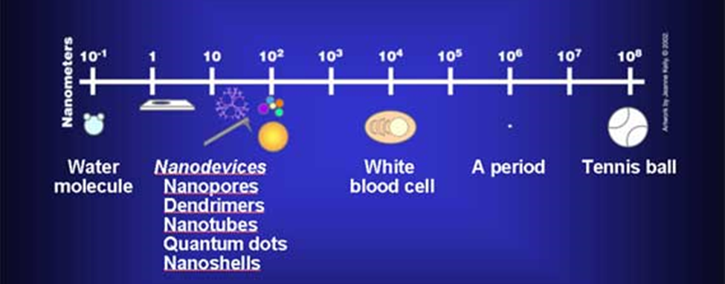
What is Nanotechnology ?
“Nanotechnology is creating, using and manipulating structures, devices, and systems that have unique properties and functions because of their nanometer scale dimensions"
Examples to illustrate Nanotechnology:
    There are 25,400,000 nanometers in an inch.
    A sheet of newspaper is about 100,000 nanometers thick.
    On a comparative scale, if a marble were a nanometer, then one meter would be the size of the Earth.

Slide 4
Industries using Nanotechnology
Scientific
Commercial
Consumer
Chemistry
Physics
Biology
Manufacturing
Engineering
Healthcare
Food Products
Lifestyle
Comfort

Slide 5
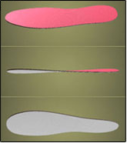


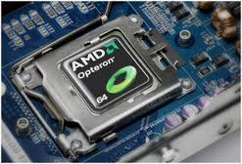
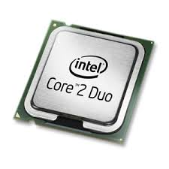
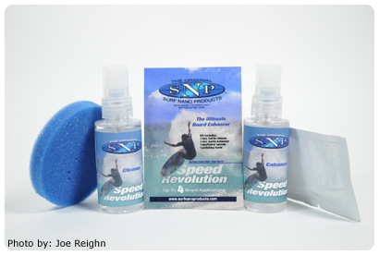
Products Offered
Q-Avail Nano Powder
Foot Warmer
Military-Grade Disinfectants
AMD Processor
Intel processor
Surf Nano

Slide 6
enterprise IR strategy – Implications
Strengths | Weaknesses
Strong collaborative nature. High capability to increase product diversification, offerings and knowledge base. Less competition. | Internal organization impacts.
Opportunities | Threats
Initial nature encourages taking advantage of governmental subsidies designed to improve the commercialization of nanotechnology. An organization can capture a high market share and leverage the knowledge of a worldwide scientific community. | There is a possible loss of profits from a technology. Ethical problems Large-scale health effects

Slide 7

Required Conditions FOR NANOTECH
Systems & processes that facilitate collaboration & communication, e.g. social networks, email, collaboration systems & file-sharing systems.
Nanomanufacturing R&D and infrastructure.
Understanding of the types & dimensions of nanoscale materials.
Specialized equipment, including scanning tunneling microscope, transmission electron microscope & atomic force microscope.
Researchers & businesses with access to this specialized equipment.
Sufficient security mechanisms to protect valuable data.

Slide 8
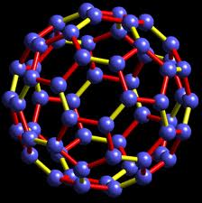
Implementation Challenges
High R&D costs (expensive specialized equipment, highly skilled employees) w long development times (3-4+ yrs).
Dynamic nature of nanotech results in rapid obsolescence.
Uncertainty of which nanotechnology will become standard.
Competition from other similar technologies.
Data security concerns.
Health & safety concerns.

Slide 9

Cost / Benefits of Nanotechnology
High costs for expensive specialized equipment
High recurring maintenance costs for equipment.
Large investments of time and resources in R&D.
Potential for very lucrative new revenue source.
Significant government subsidies & grants for nanotech research, including 2013 presidential budget.
Significant private investment capital funds available.

Slide 10
Criteria for including Nanotechnology in IR strategy
To identify opportunities for investing, companies should examine traditional markets and ask what unfilled needs might be addressed by nanotechnology.
Differentiation of products to create uniqueness.
Transferring intellectual property into commodity.
Analysis of market prior to introduction.

Slide 11
Conclusion
An organization with a strategically competitive mindset will find the potential offered by the use of nanotechnology greatly beneficial, despite the high cost.
Organizations that do not fit this description should not consider the use of nanotechnology, or at least not at the present state of nanotechnology.
Ultimately, "the well-learned rule still holds: look for a market need and apply the appropriate technology, whether that be nano or conventional technology."

Slide 12

Thank You

