Slide 1



Library Circulations & Reservations: A View of Organizing Information
By Rakhi Bharekar
Myeong Lee
Bryon Baumstarck INFM612 Final Presentation

Slide 2
Agenda
Introduction
Objectives
Methodologies
Findings
Issues
Recommendations

Slide 3
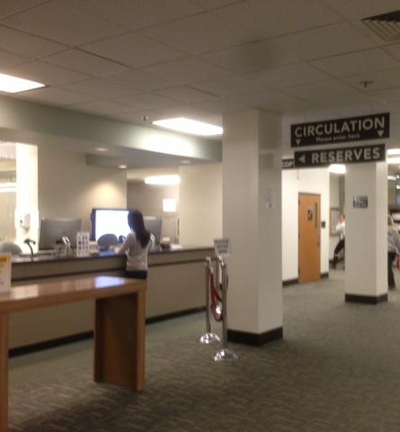
Introduction: Circulations & Reserves Desk
Information Desk and Circulations & Reserves Desk serve patrons
Primary library of the 8 libraries situated on the University of Maryland libraries
Named after former Maryland governor Theodore McKeldin (1951 - 1959), constructed in 1958
Part of the USMAI (University System of Maryland and Affiliated Institutes)
University of Maryland, Towson University, Morgan State University, Salisbury State University, St. Mary’s University, Bowie State University, etc.

Slide 4
Introduction: Services offered by Circulation & Reserves desk
Circulations & Reserves
Equipment on Loan
Book search
Inter Library Loans
Directional Help
Course reserves
Book Request

Slide 5
Introduction: External Organizational Structure
Library System
Administrative Services Division
Public Services Division
Technical Services Division
Information Services
Access Services
Dean’s Office
Information technology Division
Collection Management and Special collections division

Slide 6
Introduction: Internal Organizational Structure
Access Service Dept.
Timothy Hackman
Head, Resource Sharing & Access Services
Kristin Conlin Graduate Assistant
McKeldin Library
Circulation Desk/Reserves
Jamie Edwards
Coordinator
UMD Libraries Interlibrary Loan
Hilary Thompson
Access Service Librarian
McKeldin Library Stacks Maintenance (Vacant)
Coordinator
McKeldin Library Late Night Services Charles Wright
Coordinator
UMD Libraries Billing and Community Borrows
Evelyn Yocco
Coordinator
Ken Carps
Douvonte Farmer
Cynthia Harris
Mohammed Jaleel
Juddi Kidd (LTII)
Erica Lambert
George Ramsey
Christopher Winters
Lydia Savage
Karen Colburn
Michelle Williams
James Weber
Joshy Choorakuzhy
Kathy Pickard
Jerome Weiland
Salvador Banda-Alvarado
Adnan Qureshi
Antonio Hill
Marvin Jones

Slide 7
Agenda
Introduction
Objectives
Methodologies
Findings
Issues
Recommendations

Slide 8
Objectives
To Understand
how the Circulation & Reserves Desk organizes and manages information
management issues described in Daft’s book
To Analyze the Organization
focusing on Organizing pillar of management
focusing on Leading pillar of management

Slide 9
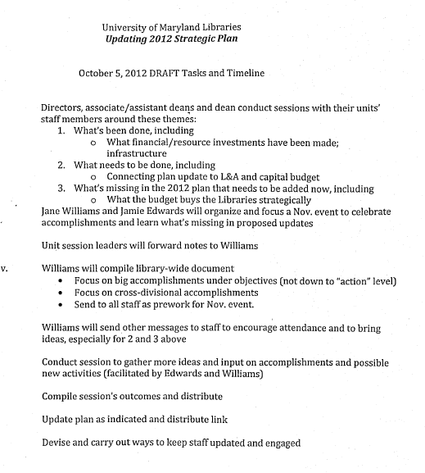
Methodologies
Interviews
Judith Kidd (Library Tech II, C&R )
Jamie Edwards (Coordinator)
Timothy Hackman (Head, Access Services)
Literature Review
Broachers, pamphlets, handouts
Strategic plans
Mission statement documents
Goals & objectives documents
Library website review
http://lib.umd.edu
http://www.kuali.org
http://umd.libanswers.com/

Slide 10
Agenda
Introduction
Objectives
Methodologies
Findings
Issues
Recommendations

Slide 11

Findings: Planning
Vision:
Success of users in their academic pursuits. By strengthening connections & contributing vigorously to the intellectual life of the campus, UM libraries will advance the university’s mission of inspiring & supporting excellence.
Mission:
UM libraries enable the intellectual inquiry and learning required to meet the education, research and community outreach mission of the university.
Goals:
Providing Information in All its Forms (Public Services division - includes Access Services)
Serving our Communities (Public Services division - includes Access Services)
Leveraging our Expertise
Creating Environments for Academic Success
Partnerships, Collaborations, and Outreach (Public Services division - includes Access Services) {only}
Employ Workforce Planning Analysis and Tools (Public Services division - includes Access Services) {only}
Notes:
Academic excellence

Slide 12
Findings: Organization adaptability, change, and innovation
Structure transition
Undergoing a structure reorganization
Employees’ self-motivation decreases resistance to the changes
Training sessions are provided
Self-directed, Informal Team
Transitioning
Vertical, Functional Team
Complementary
Some employees operate in a matrix structure across dept.
Decentralized form of authority
Notes:
Women working at the circulation is more than men

Slide 13

Findings: Technical Tools
Used to integrate ALEPH with the university enterprise learning management system (ELMS/Canvas)
ARES
Used for Inter-library loan material
ILLIAD
ALEPH
Database used to manage user accounts
Used to manage library inventory
Manages course material reservations
Email notifications and verification of availability to users
Requires extensive interaction from library staff

Slide 14
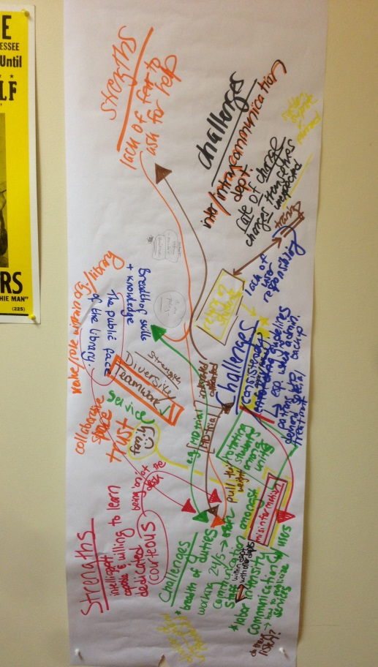
Findings: Leadership, Motivation, and Teams
Organizational Culture
Closely related to teams and leadership
Transitioning to open and innovative
External factor: Market changes to e-resources
Internal factor: Proactivity to anticipate future trends
Leadership
Hierarchical to more horizontal and authentic leadership
Ex) Team building activities, incentives
Policy Aspects: Mixed form
Top-down approach within department
Collaborative approach for consistency across departments
Notes:
Women working at the circulation is more than men

Slide 15

Findings: Management of Human Resources, Diversity, and Individual Behaviors
“Diversity is our greatest strength” – Tim Hackman, head of Resources & Access Services
Diversity
Increases quality of the team
Marketplace understanding, better service
Reduced prejudice and discrimination
Reduces effect of ethnocentrisms
Human Resource
High employee turnover
New social contract
Notes:
Women working at the circulation is more than men

Slide 16
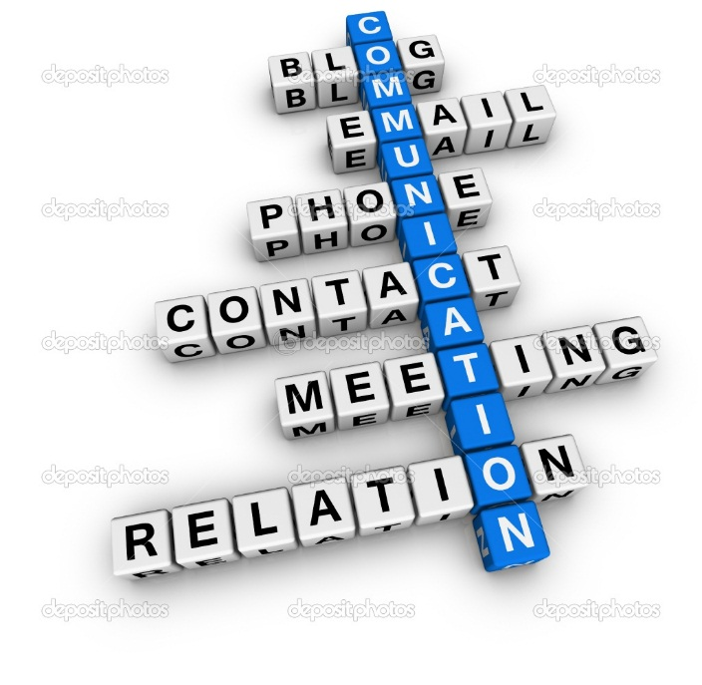
Findings: Communication
Downward
Team meetings, monthly meetings with departments, emails, intranet boards, meetings with other library heads, etc.
Upward
Patron grievances and disputes are directed to the particular coordinator in order to be resolved
Horizontal
Personal communication channels
Team communication
The coordinators are the point of contact for any
information in regards to the department
Decentralized across the organization as a whole
Notes:
Women working at the circulation is more than men

Slide 17
Agenda
Introduction
Objectives
Methodologies
Findings
Issues
Recommendations

Slide 18
Issues
Complexity and disparity of information technology systems
Loss of knowledge capital from high turnover
High degree of reliance on individual specialization
Inconsistency in the authentication systems for all the libraries under USMAI
Payment tracking is not done by the library

Slide 19
Recommendations
Continued work on integration of information systems
Increase cross-departmental staffing in order to decrease the dependence on dedicated staff for processing any task
Institute a knowledge base to mitigate loss of knowledge from turnover

Slide 20
Conclusion
Change from paper to print
Continue culture of communication, diversity, collaboration, and innovation
Become knowledge advocates

Slide 21
References
Management, Richard. L Daft, 10th edition
http://en.wikipedia.org/wiki/McKeldin_Library#McKeldin_Library
http://lib.umd.edu
http://umd.libanswers.com/
Mission statement, goals and vision
Strategic planning of the Access Services

Slide 22

Q&A

