Slide 1
Summer Institute in Earth Sciences 2009 Comparison of GEOS-5 Model to MPLNET Aerosol Data Bryon J. Baumstarck Departments of Physics, Computer Science, and Mathematics Rocky Mountain College, Billings, Montana Mentor: Dr. Peter Colarco Atmospheric Chemistry and Dynamics Branch Code 613.3 NASA Goddard Space Flight Center, Greenbelt, Maryland

Slide 2
What are Aerosols and Why do We Care About Them?
An Aerosol is any particle in the air and can be many things.
They can be;
Composed of one or more chemical components | Mostly absorbing, mostly scattering, or both
Course or fine | Spherical or non-spherical
We care about studying aerosols because of their effects on climate; however, there are large uncertainties with measuring their effects such as;
The properties of various aerosols in the atmosphere
How aerosols interact with clouds
The extent of the effects of aerosols on the environment
Lack of data resulting in inaccuracies in models
huge uncertainty
Used from the IPCC 4th Assessment Report, Working Group 1 Contribution: Climate Change 2007: The Physical Science Basis

Slide 3
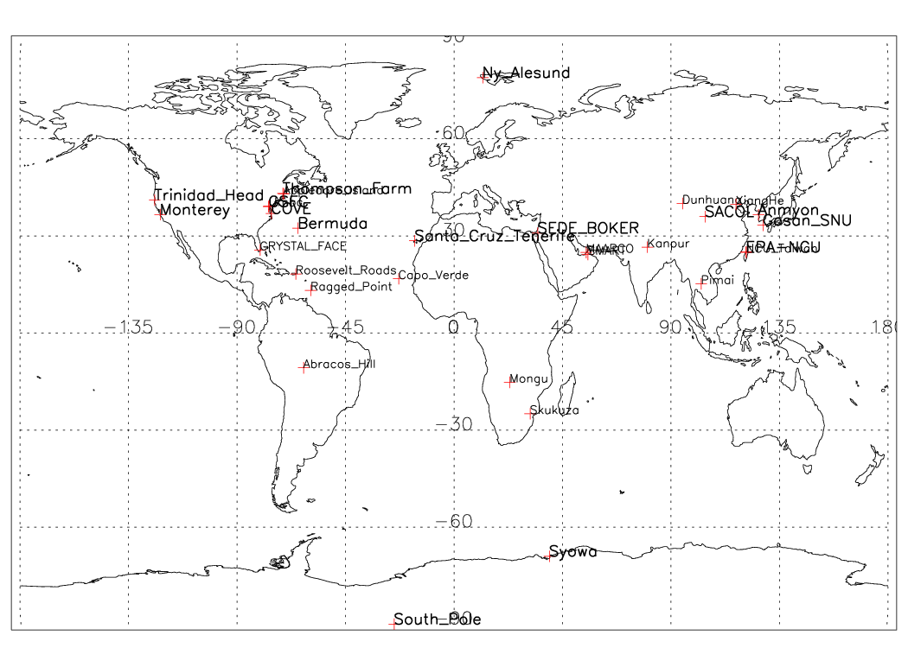
What is MPLNET?
A Federated Network of Micro-Pulse Lidar Systems
A global network to continuously measure and monitor aerosol and cloud vertical structure
Most MPLNET sites are co-located with the Aerosol Robotics Network (AERONET) sun photometer sites
Micro-Pulse Lidar Network Site Locations
Created by Bryon Baumstarck
Using data from http://mplnet.gsfc.nasa.gov/data.html and programmed in IDL

Slide 4
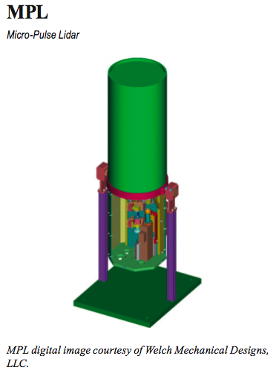
What is a Micro-Pulse Lidar?
A ground-based, compact, and eye safe laser system
Uses a 523 nm Laser shot vertically through a telescope to measure the return time and attenuation of the laser
Using algorithms created by Ellsworth J. Welton and others, one can get a large variety of products to analyze the information contained in the signal
Kinds of Data Products one is able to get with the MPLNET Data;
Level 0: Raw Data (Power, energy, etc.)
Level 1: NRB Data (Shows overall vertical structure over time)
Level 1.5a: Real Time Aerosol Properties (Backscatter, Extinction, Optical Depth, etc.)
Level 1.5b: Real Time Height Information (Shows the height of various aerosol layers and is algorithm based)
Level 1.5c: Real Time Cloud Properties (Developmental)
Level 1.5d: Polar Stratospheric Clouds (Developmental)
from the Laboratory for Atmospheres Instrument Systems Report, 2005

Slide 5
What is Aerosol Optical Depth and How is it Measured?
Aerosol
Aerosol Optical Depth (AOD) is a measure of the amount of light that is extinguished from the sun to the surface.
Column AOD is measured by sun photometers, such as those in AERONET, by measuring the total amount of light in the column that is blocked.
Distance
+Aerosol
+Cloud
+Molecular
Scattering
This value is then used as a constraint on the data from MPLNET to get the backscatter, extinction, and lidar AOD.
Lidar

Slide 6
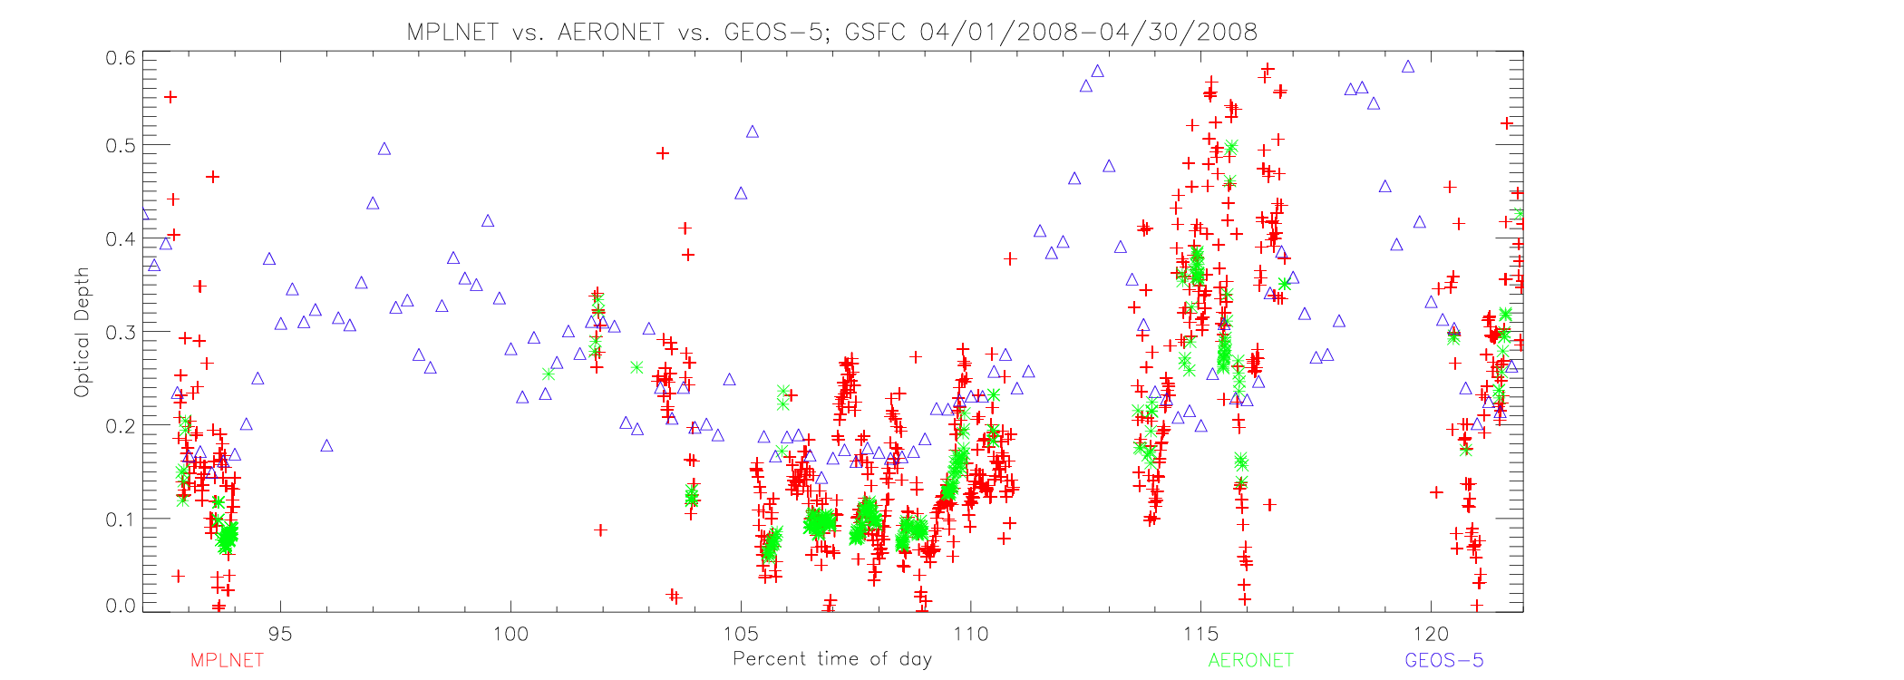
Difference between MPLNET Gridded AOD, AERONET time AOD, and GEOS-5 AOD at the Surface.
April 16, 2008
Optical Depth
Day of Year (April 1, 2008

Slide 7
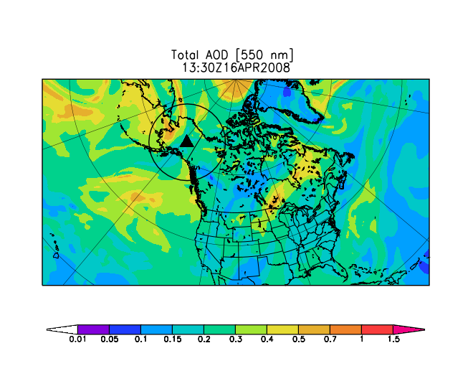
What is the model and why is it needed?
The model that is being used is the GEOS-5 model which is comprised of various modules. The GEOS-5 model is an Atmospheric General Circulation Model. The model has a ½° by ⅔° grid resolution.
The model is needed to fill in the gaps of missing data. This is needed because the data might have gaps due to restraints with the instrument, human mistakes with the instrument (like covering the signal), and movement, or decommissioning, of the instrument.
Total AOD from GEOS-5 for April 16, 2008.
The model is also needed to show future predictions. This is critical in understanding and measuring the effects of climate change, and measuring effects of policy changes.

Slide 8
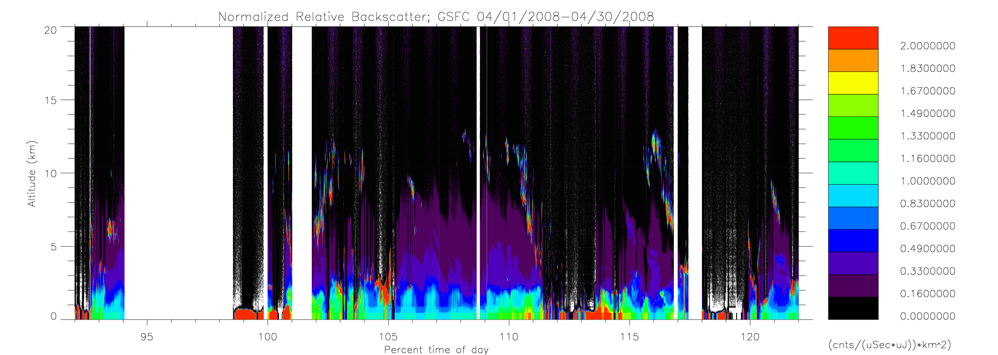
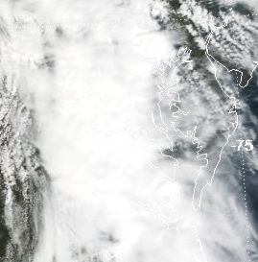
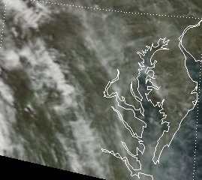
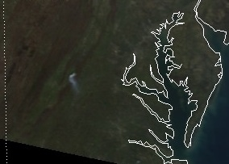
Normalized Relative Backscatter and Layer Height Information.
April 2008.
Cloud
Lack of data
True Color Visible Images from MODIS
Complete attenuation of Lidar signal at the surface
GSFC, April 18th, 2008
(day 109)
GSFC, April 19th, 2008
(day 110)
GSFC, April 19th, 2008
(day 111)

Slide 9
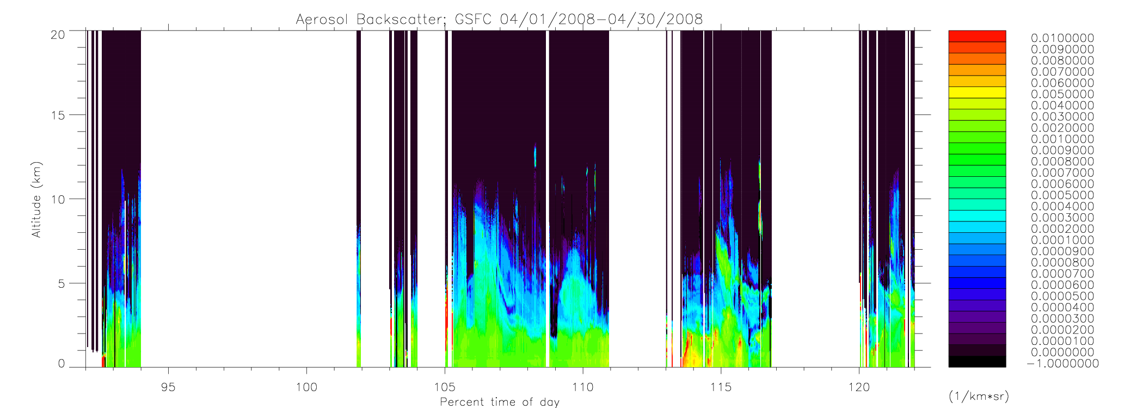
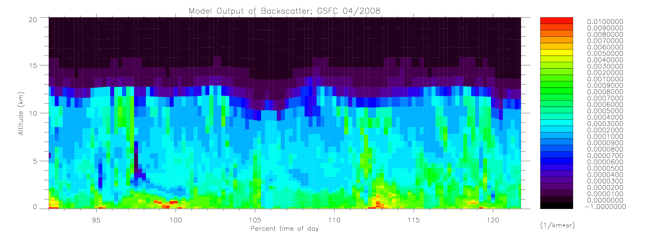
MPLNET vs. GEOS-5: Aerosol Backscatter.
April 2008.
MPLNET
Altitude (km)
Day of year (April 1st, 2008)
Possible correlation?
GEOS-5

Slide 10
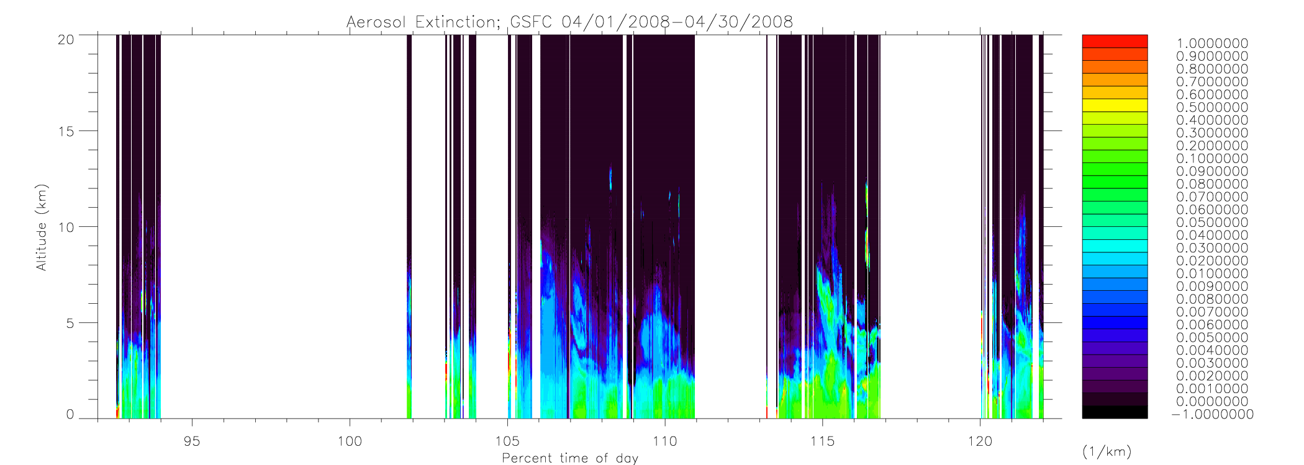
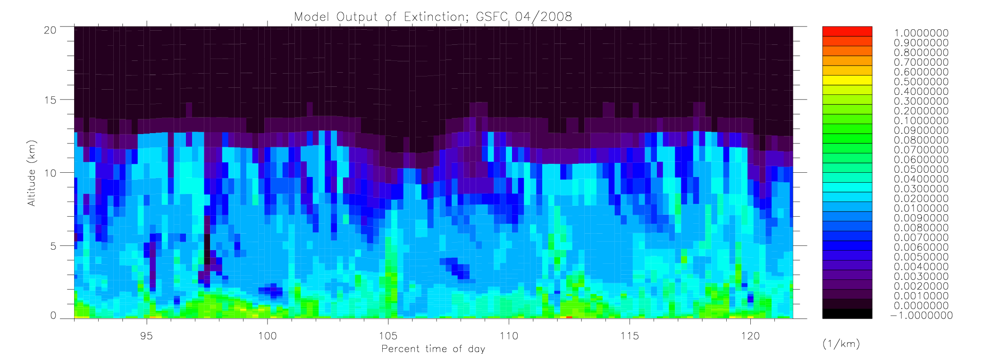
MPLNET vs. GEOS-5: Aerosol Extinction.
April 2008.
MPLNET
Altitude (km)
Day of year (April 1st, 2008)
GEOS-5

Slide 11
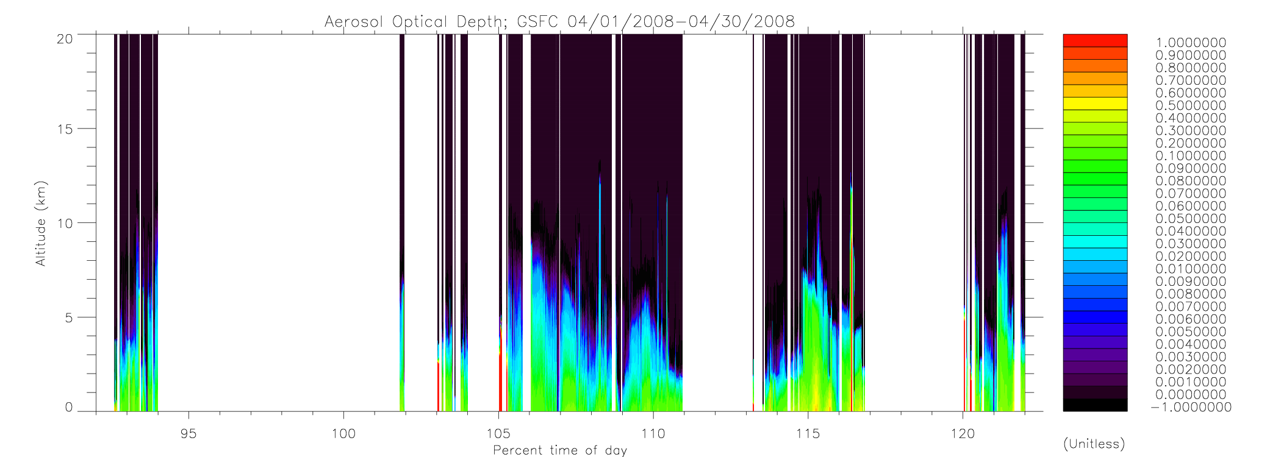
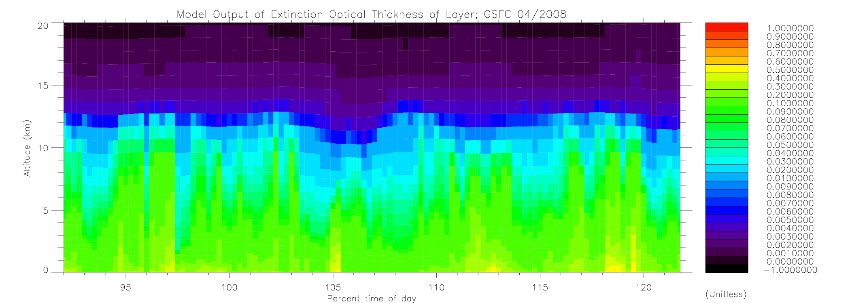
MPLNET vs. GEOS-5: Cumulative Aerosol Optical Depth.
April 2008
MPLNET
Altitude (km)
Day of year (April 1st, 2008)
Possible correlation?
GEOS-5

Slide 12
In conclusion…
The model is underestimating the MPLNET backscatter, extinction, and AOD values.
The model is overestimating the height of the aerosols.
Little or no apparent visual correlation to the actual MPLNET data.
Future projects…
Find error in correlation. This error could be due to many factors.
1.) The difference in temporal coverage, as the model is on a 6 hour average and MPLNET is on a 20 minute average.
2.) The difference in spatial coverage, as the model covers a grid area of approximately 50 km and MPLNET is a point.
3.) The problem might not even be related to the model at all, but to the uncertainty in aerosol data in general as discussed at the beginning of this presentation.
Connect individual site’s data into a mosaic to get a more accurate analysis of aerosol long-range transport.

Slide 13
Thank You’s
A HUGE thank you to Peter Colarco for being my mentor for this project.
A special thank you to Ellsworth J. Welton, MPLNET Principle Investigator, for answering questions about MPLNET and for the data used in this project.
A grateful thanks goes to Valerie Casasanto, and others, for coordinating the Internship program.
And… THANK YOU NASA!!!

